Slide 1
A common neural basis for contrast and motion coherence discrimination
Dan Birman
Frisem 2017-06-26

Slide 4
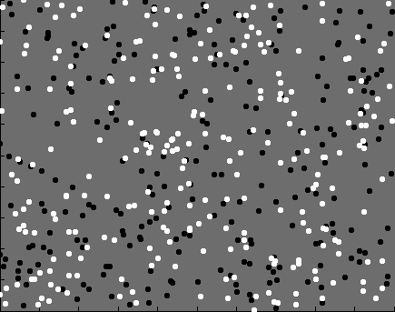

Slide 5
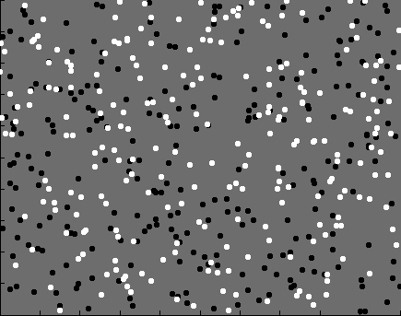
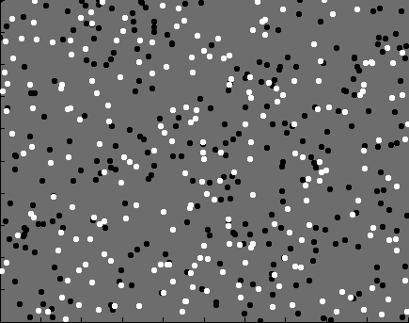
Contrast

Slide 6
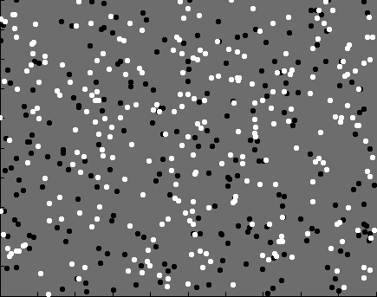
Coherence

Slide 7


Slide 8
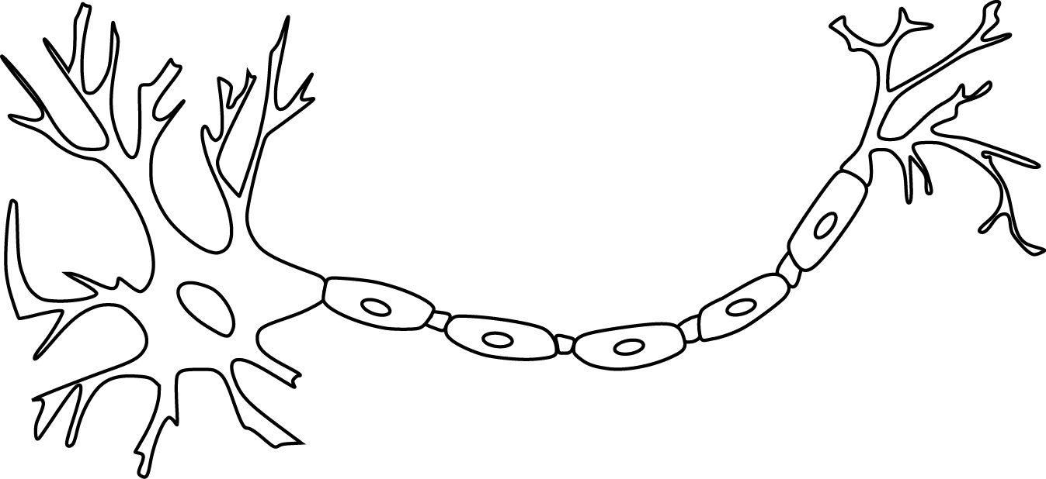

Slide 10
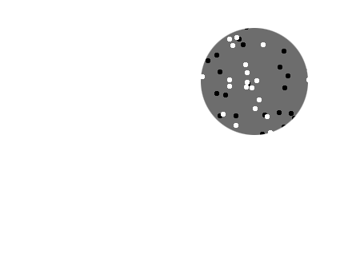
Receptive field

Slide 11
Receptive field

Slide 12
Population
Receptive field

Slide 14
~ 2.5 mm
~ 2.5 mm
~ 2.5 mm

Slide 15
~ 2.5 mm
~ 2.5 mm
~ 2.5 mm
Millions of neurons

Slide 17
Perception is linked to population representations

Slide 18
Representation of contrast?
Boynton et al. 1999

Slide 19
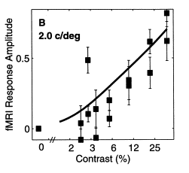
Representation of contrast?
Boynton et al. 1999

Slide 20
Representation of contrast?
Boynton et al. 1999
Representation of coherence?
Rees and Koch 2000

Slide 21
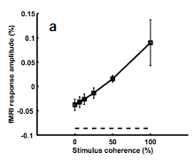
Representation of contrast?
Boynton et al. 1999
Representation of coherence?
Rees and Koch 2000

Slide 22
Representation of contrast?
Boynton et al. 1999
Representation of coherence?
Rees and Koch 2000

Slide 25
Contrast

Slide 26
Contrast

Slide 27
Contrast

Slide 28
Contrast
Coherence

Slide 29
Contrast
Coherence

Slide 30
Contrast
Coherence

Slide 31
Contrast
Coherence

Slide 32
Goal: A model of how voxels represent (encode) contrast and motion coherence

Slide 33
Goal: A model of how voxels represent (encode) contrast and motion coherence
Voxel representation from cortical measurements of BOLD fMRI
Prediction and comparison to a behavioral measure of visibility

Slide 34
Goal: A model of how voxels represent (encode) contrast and motion coherence
Voxel representation from cortical measurements of BOLD fMRI
Prediction and comparison to a behavioral measure of visibility

Slide 35
Goal: A model of how voxels represent (encode) contrast and motion coherence
Voxel representation from cortical measurements of BOLD fMRI
Prediction and comparison to a behavioral measure of visibility

Slide 39
Luminance changes = bad

Slide 45
Cortical measurements: task at fixation

Slide 46
Cortical measurements: task at fixation
11 observers, asynchronous task at fixation
800+ trials (20 per experimental condition)
1 hr retinotopy
4 x 2 hr scanning sessions

Slide 47
Area V1
Area MT

Slide 49
Within-subject analysis: display average across subjects

Slide 50
Within-subject analysis: display average across subjects
Timecourses were averaged across ROIs

Slide 51
Within-subject analysis: display average across subjects
Timecourses were averaged across ROIs
Deconvolution (GLM/finite impulse response) used to obtain separated per-condition measurements

Slide 53
Contrast

Slide 54
Contrast
Coherence

Slide 55
Contrast
Stimulus length
Coherence

Slide 69
Contrast

Slide 70
Contrast
Coherence

Slide 71
Contrast
Stimulus length
Coherence

Slide 74
Neural response model for cortical measurements

Slide 77
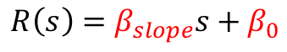
$$R\left(s\right)=β_{slope}s+β_{0}$$
Feature strength

Slide 78
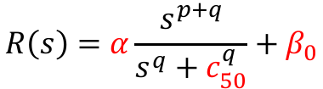
$$R\left(s\right)=β_{slope}s+β_{0}$$
$$R\left(s\right)=α\frac{s^{p+q}}{s^{q}+c_{50}^{q}}+β_{0}$$
Feature strength

Slide 79

$$R_{onset}$$
$$R\left(s\right)=β_{slope}s+β_{0}$$
$$R\left(s\right)=α\frac{s^{p+q}}{s^{q}+c_{50}^{q}}+β_{0}$$
Feature strength

Slide 81
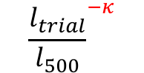
$${\frac{l_{trial}}{l_{500}}}^{−κ}$$

Slide 82
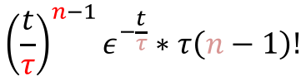
$${\left(\frac{t}{τ}\right)}^{n−1}ε^{−\frac{t}{τ}}∗τ\left(n−1\right)!$$

Slide 103
Is the motion coherence response linear?

Slide 104
Is the motion coherence response linear?

Slide 105
Is the motion coherence response linear?

Slide 106
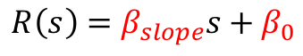
Is the motion coherence response linear?
$$R\left(s\right)=β_{slope}s+β_{0}$$
Feature strength

Slide 107
Is the motion coherence response linear?
$$R\left(s\right)=β_{slope}s+β_{0}$$
Feature strength

Slide 108
Is the motion coherence response linear?
$$R\left(s\right)=β_{slope}s+β_{0}$$
Feature strength

Slide 109
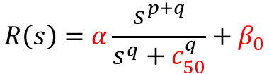
Is the motion coherence response linear?
$$R\left(s\right)=β_{slope}s+β_{0}$$
$$R\left(s\right)=α\frac{s^{p+q}}{s^{q}+c_{50}^{q}}+β_{0}$$
Feature strength

Slide 110
Is the motion coherence response linear?
$$R\left(s\right)=β_{slope}s+β_{0}$$
$$R\left(s\right)=α\frac{s^{p+q}}{s^{q}+c_{50}^{q}}+β_{0}$$
Feature strength

Slide 111
Is the motion coherence response linear?

Slide 112
Is the motion coherence response linear?

Slide 113
Is the motion coherence response linear?

Slide 114
Is the motion coherence response linear?

Slide 115
Is the motion coherence response linear?

Slide 116
Goal: A model of how voxels represent (encode) contrast and motion coherence
Voxel representation as measured from cortical signals with fMRI
Prediction and comparison to a behavioral measure of visibility

Slide 117
Goal: A model of how voxels represent (encode) contrast and motion coherence
Voxel representation as measured from cortical signals with fMRI
Prediction and comparison to a behavioral measure of visibility

Slide 120
11 fMRI observers, 21 behavioral observers (1000—2500 trials)

Slide 138
Neural response model for behavioral measurements

Slide 142
$$r_{trial}=β_{con}R\left(Δs_{con}\right)+β_{coh}R\left(Δs_{coh}\right)+β_{bias}$$

Slide 145
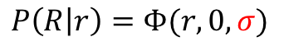
$$P\left(R | r\right)=Φ(r,0,σ)$$

Slide 146
Smaller sigma
(less noise)

Slide 147
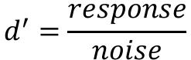
$$d^{′}=\frac{response}{noise}$$
Smaller sigma
(less noise)

Slide 148
Response model:
Linear vs. nonlinear
Noise model:
Additive vs. poisson

Slide 149
Response amplitude (s.d.)
Stimulus strength (%)

Slide 150
Response amplitude (s.d.)
Stimulus strength (%)

Slide 151
Response amplitude (s.d.)
Stimulus strength (%)

Slide 152
Response amplitude (s.d.)
Stimulus strength (%)

Slide 153
Response amplitude (s.d.)
Stimulus strength (%)

Slide 154
Response amplitude (s.d.)
Stimulus strength (%)

Slide 155
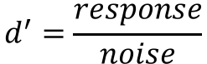
Response amplitude (s.d.)
$$d^{′}=\frac{response}{noise}$$
Stimulus strength (%)

Slide 156
Response amplitude (s.d.)
$$d^{′}=\frac{response}{noise}$$
Stimulus strength (%)

Slide 161
Response amplitude (s.d.)
Stimulus strength (%)

Slide 162
Response amplitude (s.d.)
$$d^{′}=\frac{response}{noise}$$
Stimulus strength (%)

Slide 166
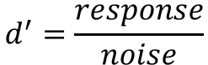
Response amplitude (s.d.)
$$d^{′}=\frac{response}{noise}$$
Stimulus strength (%)

Slide 170
Is the underlying noise additive or Poisson?

Slide 171
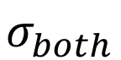
$$σ_{both}$$
0
Response model
0
Response model
0
0
Noise model
Noise model

Slide 172
$$σ_{both}$$
0
Response model
Response model
0
0
0
Noise model
Noise model

Slide 173
$$σ_{both}$$
0
Response model
Response model
0
0
0
Noise model
Noise model

Slide 174
$$σ_{both}$$
0
Response model
Response model
0
0
Noise model
Noise model

Slide 175
$$σ_{both}$$
0
Response model
Response model
0
Noise model
Noise model

Slide 176

$$σ_{both}$$
$$σ_{contrast},σ_{coherence}$$
Response model
0
Response model
0
Noise model
Noise model

Slide 177
$$σ_{both}$$
$$σ_{contrast},σ_{coherence}$$
Response model
Response model
0
0
Noise model
Noise model

Slide 178
$$σ_{both}$$
$$σ_{contrast},σ_{coherence}$$
Response model
Response model
0
0
Noise model
Noise model

Slide 179
$$σ_{both}$$
$$σ_{contrast},σ_{coherence}$$
Response model
Response model
0
0
Noise model
Noise model

Slide 180
$$σ_{both}$$
$$σ_{contrast},σ_{coherence}$$
Response model
Response model
0
Noise model
Noise model

Slide 181
Goal: A model of how voxels represent (encode) contrast and motion coherence
Voxel representation as measured from cortical signals with fMRI
Prediction and comparison to a behavioral measure of visibility

Slide 182
Goal: A model of how voxels represent (encode) contrast and motion coherence
Voxel representation as measured from cortical signals with fMRI
Prediction and comparison to a behavioral measure of visibility

Slide 183
Goal: A model of how voxels represent (encode) contrast and motion coherence
Voxel representation as measured from cortical signals with fMRI
Evidence for similar nonlinear (Naka-Rushton) response functions to contrast and motion coherence
Prediction and comparison to a behavioral measure of visibility

Slide 184
Goal: A model of how voxels represent (encode) contrast and motion coherence
Voxel representation as measured from cortical signals with fMRI
Evidence for similar nonlinear (Naka-Rushton) response functions to contrast and motion coherence
Prediction and comparison to a behavioral measure of visibility

Slide 185
Goal: A model of how voxels represent (encode) contrast and motion coherence
Voxel representation as measured from cortical signals with fMRI
Evidence for similar nonlinear (Naka-Rushton) response functions to contrast and motion coherence
Prediction and comparison to a behavioral measure of visibility
Judgments of contrast and motion coherence appear to be read out under additive noise

Slide 186

Thanks!
Another person involved in this project:
Justin Gardner

